Slide 1
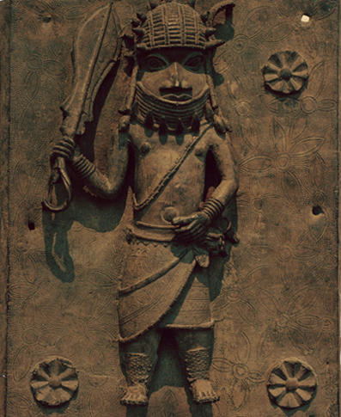
The Muslim World and Africa (730 B.C.–A.D. 1500)
Lesson 6 Kingdoms of West Africa

Slide 2
The Muslim World and Africa (730 B.C.–A.D. 1500)
Lesson 6 Kingdoms of West Africa
Learning Objectives
Analyze how the gold and salt trade in Africa facilitated the spread of ideas and trade.
Describe how the rulers of Ghana, Mali, and Songhai built strong kingdoms.
Summarize how other West African societies developed.

Slide 3
Trade Grows Across the Sahara
Trading Patterns Emerge
A trade network is going to emerge from West Africa to North Africa and the Middle East
West Africa will export leather goods, kola nuts, cotton cloth and enslaved people
North Africa will bring silk, metal, beads, and horses to south of the Sahara, and also their religion and beliefs
Trading Gold for Salt
Gold and Salt dominate Saharan trade
Gold is found in present day Nigeria, Ghana, and Senegal
The gold will make its way into North Africa and Europe
They will trade the gold for salt b/c south of the Sahara salt is scarce
All this trade will bring ideas and religions to new areas and help make stable kingdoms

Slide 4
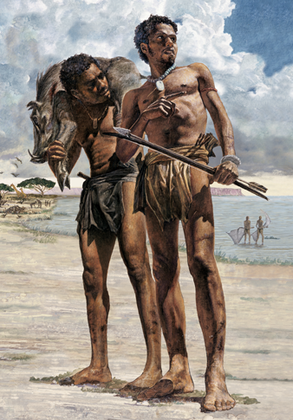
Trade Grows Across the Sahara
As Neolithic people began farming, many still relied on hunting for their food.

Slide 5
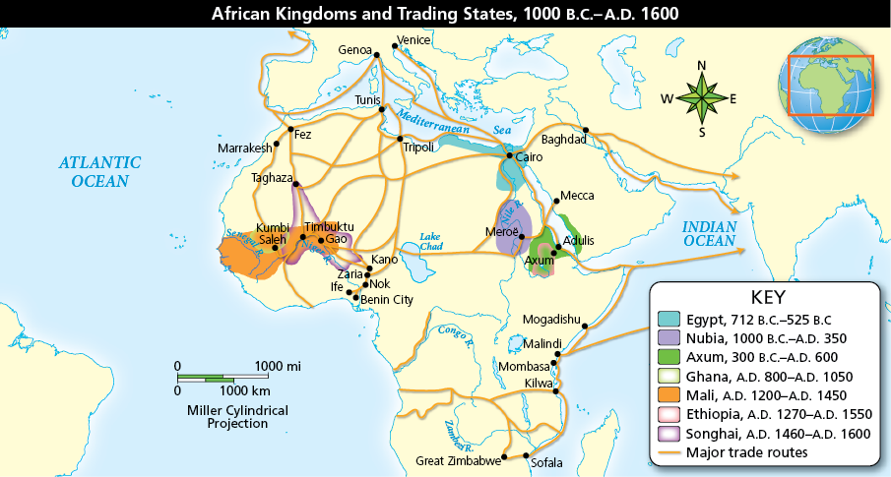
Trade Grows Across the Sahara
Analyze Maps The people of early Africa developed a system of trade routes that connected much of the continent. Why do you think most of these trade routes bordered oceans and rivers?

Slide 6
Ghana
Gold Wealth of Ghana
The rulers of Ghana control the gold salt trade across West Africa due to their location
The King collected tolls on things entering and leaving Ghana, earning the city the nickname “The Land of Gold”
The King and His Court
Kumbi Saleh was the last great capital of Ghana
It was 2 separate walled towns
The King lived in the first town, the royal palace surrounded by a complex of domed buildings
In the 2nd town prosperous Muslim merchants from north of the Sahara lived there, in order to trade

Slide 7
Ghana
Islam’s Influence
The King is going to use Muslims as officials and counselors
Ghana is going to adopt some military ideas and ideas about government from the Muslims
Muslim merchants are going to introduce Arabic language and writing. Islamic scholars and clerics will travel with merchants bringing ideas of education learning
Other rulers will adopt Islam as their religion, leading to their countries converting as well
Ghana Declines
In 1050 Almoravids (Muslims) will invade from North Africa and take over Ghana
They will conquer Ghana briefly but will not be able to hold it, it is too far away to govern properly
Ghana will continue to decline until it is taken over by the Mali

Slide 8
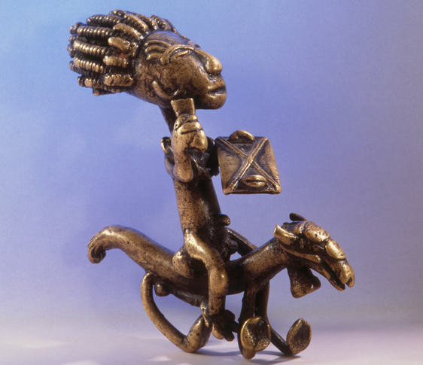
Ghana
In the 1400s, a system of using standardized weights in the form of brass figures, such as this one from Ghana, to weigh the gold dust currency was developed in West Africa.

Slide 9
Mali
Mansa Musa: Mali’s Greatest Ruler
Comes into power in 1312, pushes westward to the Atlantic Ocean and north to capture cities
He will convert to Islam but does not force his subjects to convert, will promote religious tolerance
Mansa Musa’s Pilgrimage
In 1324 he will fulfill one of his obligations as a Muslim and make a pilgrimage to Mecca
This will allow him to forge diplomatic and economic ties with other Muslim countries
He will come back home with scholars, architects, and teachers
These people will introduce Arab style to palace and mosques and help foster education.
Word of his pilgrimage will reach Europe who will be interested in the gold as they are starting to use gold coins

Slide 10
Mali
Analyze Data Mansa Musa’s pilgrimage to Mecca in 1324 was a sight to behold as he traveled in grand style. Based on the numbers, what percentage of those who traveled with him were enslaved?

Slide 11
Mali
Growth of Timbuktu
On his way back home Mansu will build a mosque and a palace here
The city will draw hundreds of Muslim scholars like doctor, priests, and judges
The University of Timbuktu will reportedly have 25000 students at its height.
The university will reflect on Islam’s emphasis on education and showed how Islam spread peacefully through trade and centers of learning

Slide 12
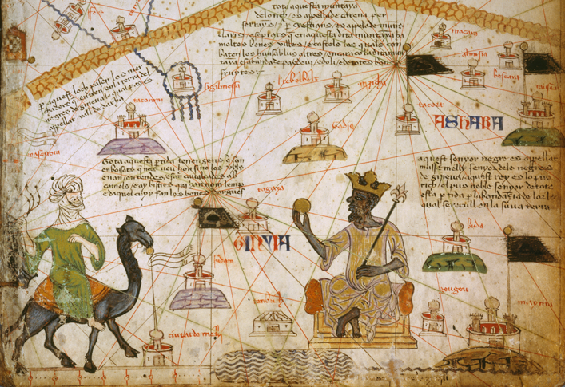
Mali
Draw Conclusions In this 1325 world map, Mali ruler Mansa Musa is offering gold to a trader. What does this image say about Mansa Musa and the Mali empire?

Slide 13
Songhai
An Empire Expands
Songhai develops on the Niger River, in present day Mali and Niger. Gao is its capital
Soldier king Sonny Ali (1464-1492) is going to create the largest state that existed in West Africa
He is going to bring in wealthy cities and trade routes under his control
He is not Muslim
Emperor Askia Muhammad is going to set up a Muslim dynasty after Sonny’s death. He will set up a bureaucracy with different departments for farming, military, and the treasury
Askia will make a pilgrimage to Mecca which leads to scholars coming to his court in Gao
Askia will build mosques and schools to study the Quran

Slide 14
Songhai
Invaders from the North
Songhai will continue to prosper after Askia’s death (1528) but questions about who takes over after his death will lead to a civil war (1586)
Morocco will send armies south to take over the gold mines using gunpowder weapons.
They will succeed but like the Almoravids who take over Ghana, they cannot rule a country so far away.
Songhai will splinter into many small kingdoms.

Slide 15
Songhai
Founded in the 5th century, Timbuktu was a great cultural, religious, and economic center. The city reached the height of its power in the 1400s and 1500s.

Slide 16
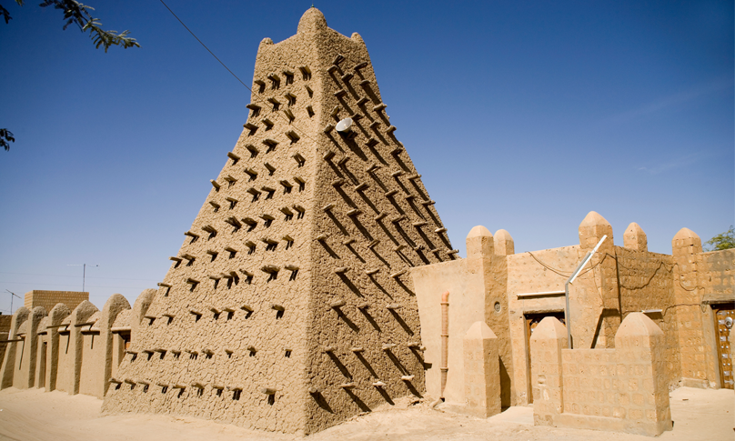
Songhai
The Sankore Mosque in Timbuktu underscored the importance of education and of Islam in that city.

Slide 17
Small Societies and Kingdoms of West Africa
Benin: A Forest Kingdom
Located in the rainforest of the Guinea coast
Traded pepper, ivory, and later slaves
The king was called the oba and he was a political, judicial, and religious leader
3 mile long wall surround the capital city
Ife, a nearby forest kingdom, is going to teach the Benin how to cast in bronze and brass. They are going to create sculptures of the faces of the queen, the oba and later on bearded Portuguese traders

Slide 18
Small Societies and Kingdoms of West Africa
Artists working in Benin sculpted many figures in bronze, including this warrior.

Slide 19
Small Societies and Kingdoms of West Africa
Walled City-States of the Hausa
The Hausa built clay walls and established independent city states in the 1300’s
These cities will become thriving trade centers
Kano will be the largest of these cities with 12 miles of walls and up to 50 feet in height. It’s greatest king Muhammad Rumfa was Islam and during his reign a written lauguage with Arabic script will be created and Islamic law influenced government
Many Hausa rulers were women, including Amina from Zazzau. She will conquer Kano and other cities and will dominate Saharan trade routes

Slide 20
Quiz: Trade Grows Across the Sahara
Salt played a key role in the development of West Africa because
A. it caused fierce rivalry among neighboring kingdoms.
B. it encouraged trade and brought new religion to the region.
C. it allowed outsiders to dictate what African culture should be.
D. it began the process of European colonization in the region.

Slide 21
Quiz: Ghana
Which statement best describes the overall impact of Muslim merchants on the city of Kumbi Saleh?
A. Muslim merchants controlled the city’s government.
B. Muslim merchants were a small part of the city’s society.
C. Muslim merchants displaced local residents in many neighborhoods of the city.
D. Muslim merchants and traders made the city a bustling center for commerce.

Slide 22
Quiz: Mali
Mansa Musa was the greatest ruler of Mali. During his reign he
A. ensured peace and prosperity by waging preemptive wars against his enemies.
B. expanded the kingdom’s borders and forged ties with other Muslim lands.
C. ensured peace and prosperity when he unified the kingdom by making his subjects convert to Islam.
D. expanded Mali’s borders to the Atlantic Ocean and unified the kingdom by making his subjects convert to Islam.

Slide 23
Quiz: Songhai
How was Sonni Ali able to create such a wealthy kingdom?
A. He converted to Islam, strengthening commerce between Songhai and other kingdoms.
B. He forged military alliances with other nations, bringing more wealth to Songhai.
C. He expanded the exploitation of Songhai’s natural resources, allowing Songhai to prosper.
D. He brought trade routes under Songhai’s control, allowing the kingdom to flourish.

Slide 24
Quiz: Small Societies and Kingdoms of West Africa
How did the prosperity of West Africa’s smaller societies compare with Africa’s much larger kingdoms?
A. As in the larger kingdoms, farming and trading were key to prosperity.
B. As in larger kingdoms, military might was key to prosperity.
C. As in larger kingdoms, roads were key to prosperity.
D. As in larger kingdoms, Christianity was the key to prosperity.

